Slide 1


COACHING INSTITUTE MANAGEMENT SYSTEM
Presented By-
Rajeev Swarnakar (219138)
Rishikesh Turkar (219144)

Slide 2
Points to be discussed
INTRODUCTION
OBJECTIVES
DIAGRAMS
PLATFORM USED
ADVANTAGES
DISADVANTAGES
CONCLUSION
REFERENCES

Slide 3
Introduction
A web portal for making coaching education system easier by providing facilities to the Student , Faculty and Admin of recording study materials, quiz and all the other things useful for management of coaching institutes.

Slide 4
Objectives
To lessen the gap in communication
As we have seen, parent-teacher meetings are organized to conduct the parents communication with the parents so that they can know about their kids performance and other activities. But these meetings are not daily basis, so the parents dont have a clear idea about the performance of their kids and are unaware of their growth. Here institute management software works as a bridge between the teachers, students, and parents through instant warning, and notification.
Manage Online Education
This software helps manage Student, Faculty, Courses, Attendance, and Notes. The software guarantees saving of money and time for owners apart from organizing the institute information. You can streamline the coaching institute business.

Slide 5
Technology Used:
Front End: React
Back End: Java Spring Boot API.
Database My SQL

Slide 6
UML Diagrams
Diagrams drawn are-

Slide 7
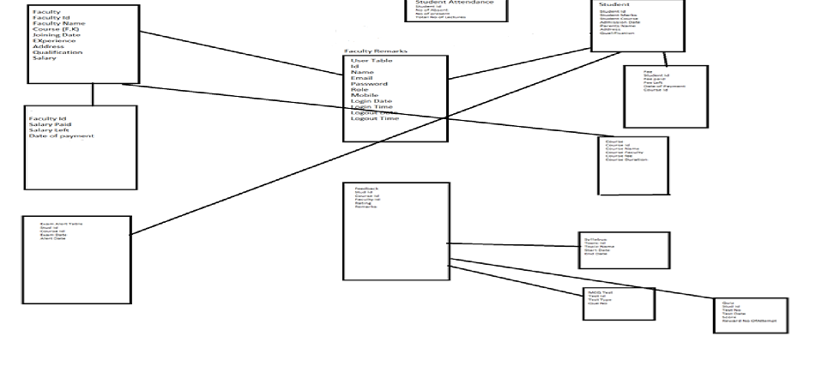
E-R Diagram

Slide 8
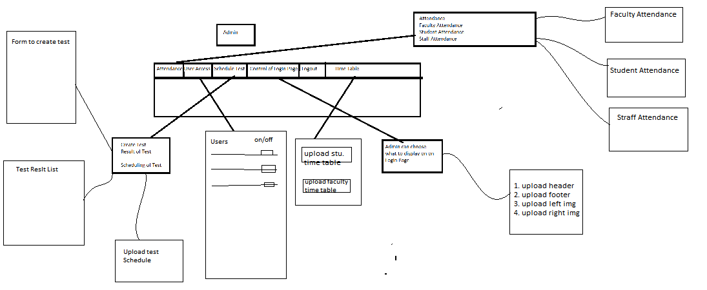
Page Flow Diagrams
ADMIN FLOW

Slide 9
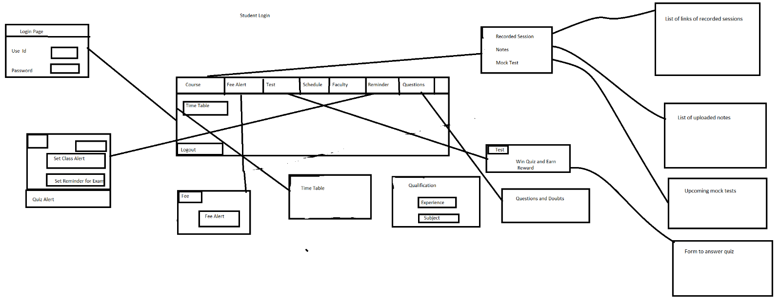
STUDENT FLOW

Slide 10
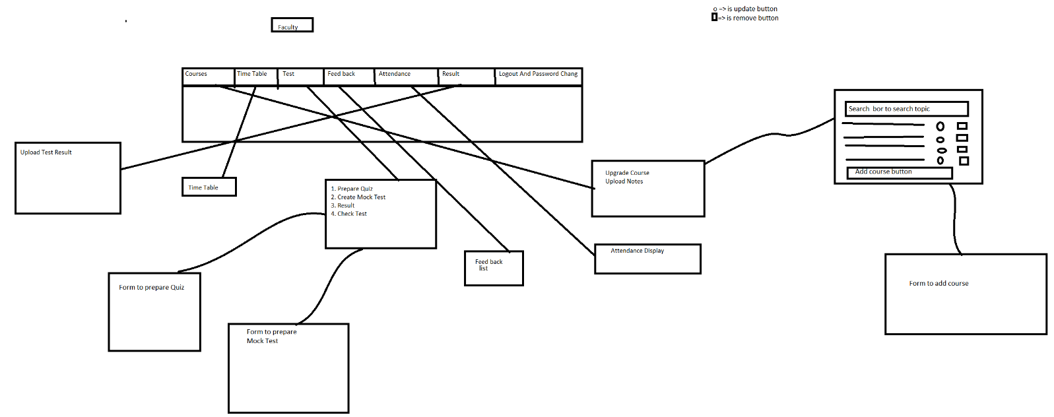
FACULTY FLOW

Slide 11
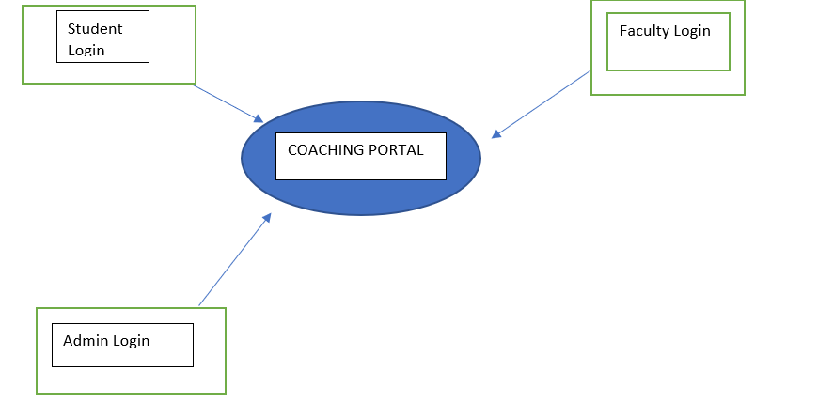
ZERO LEVEL DFD

Slide 12
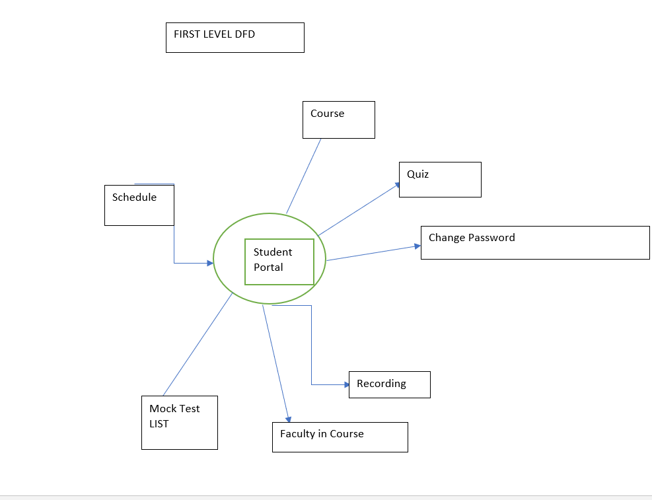

Slide 13
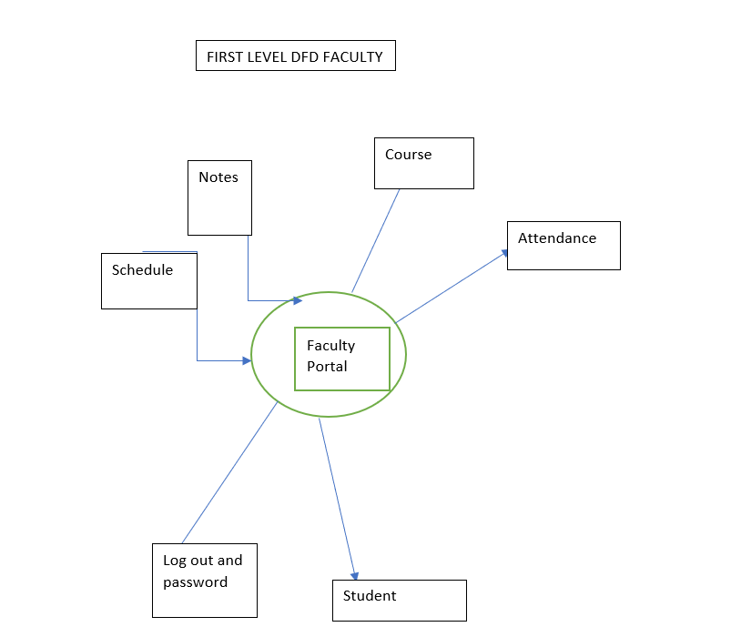

Slide 14
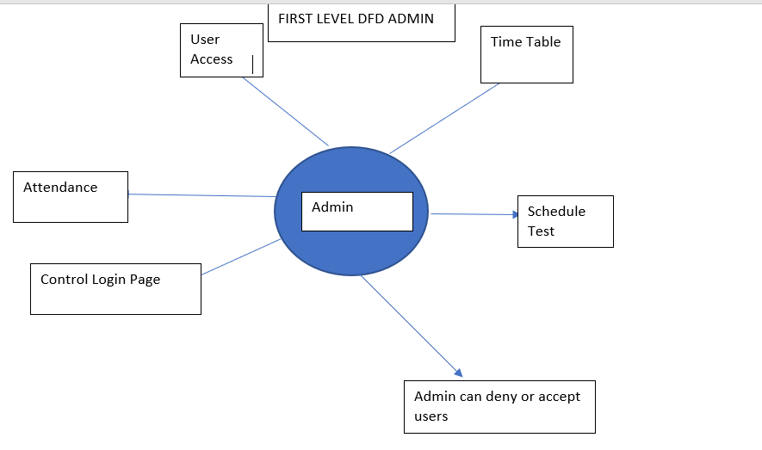

Slide 15
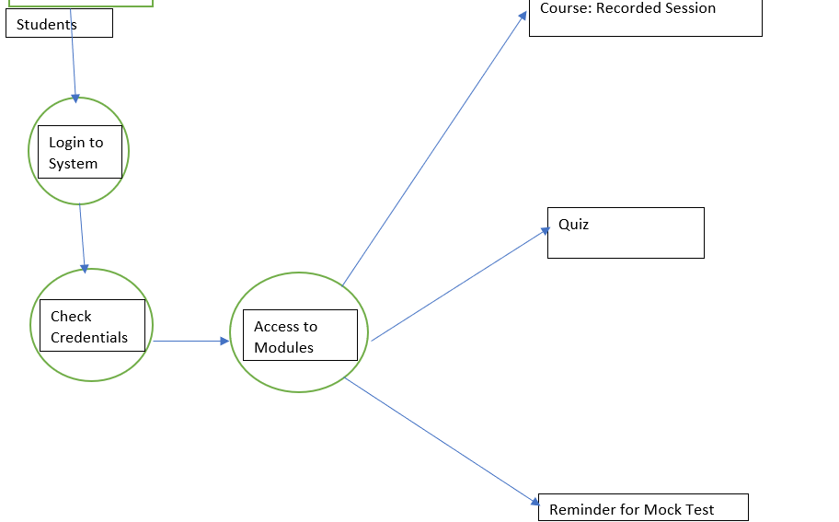

Slide 16
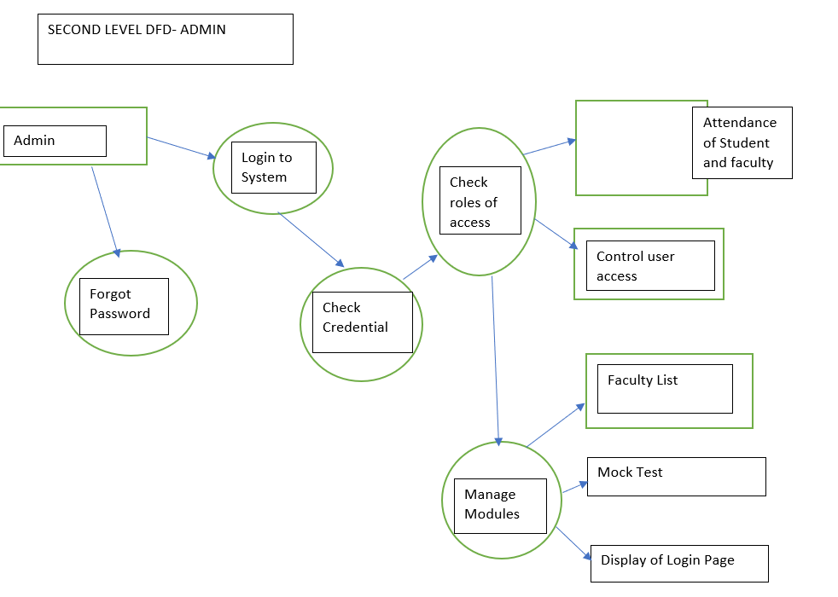

Slide 17
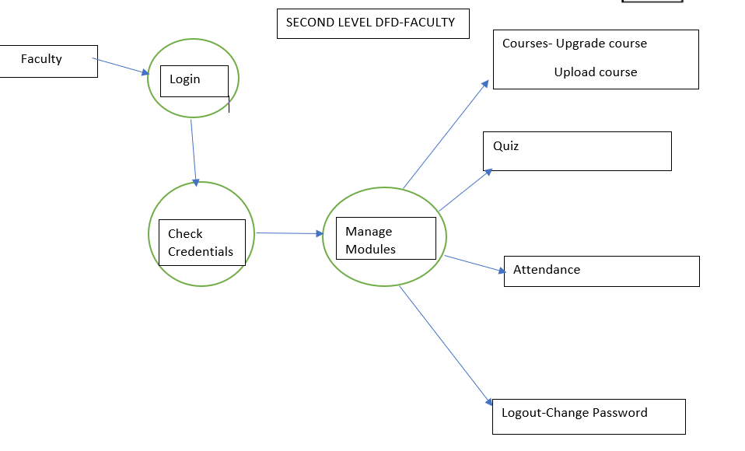

Slide 18
Screen Shots

Slide 19
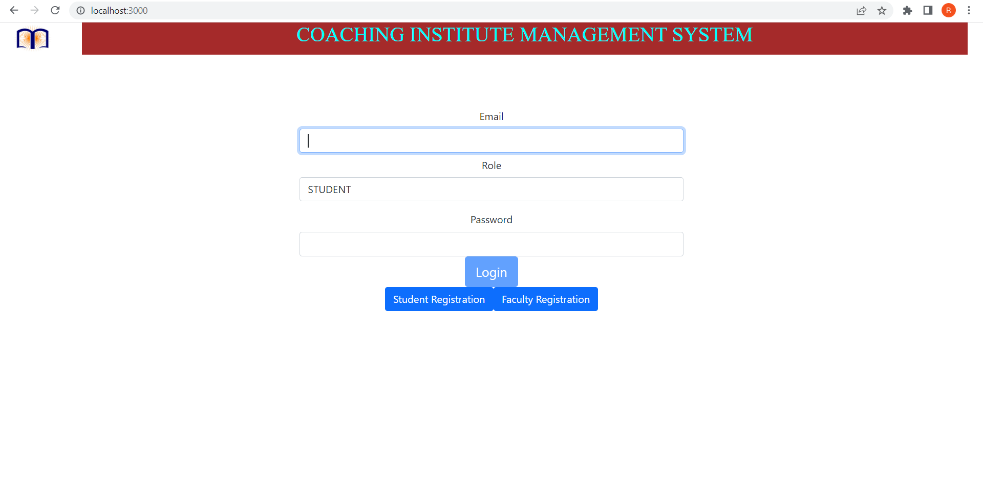

Slide 20

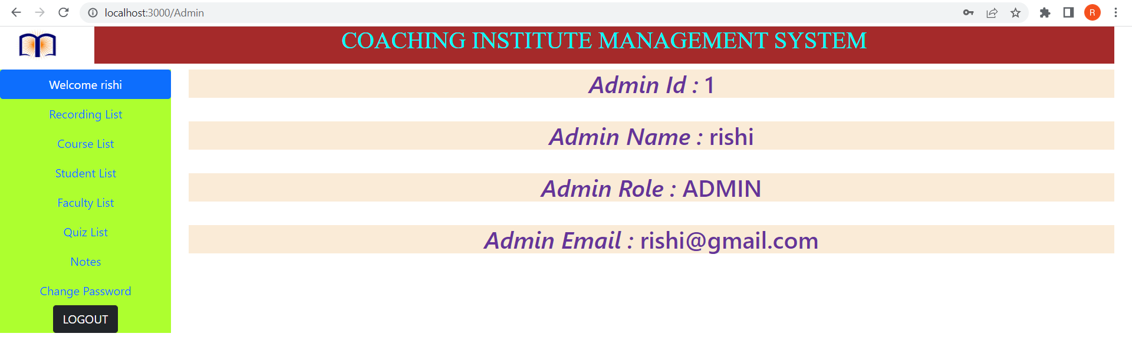

Slide 21
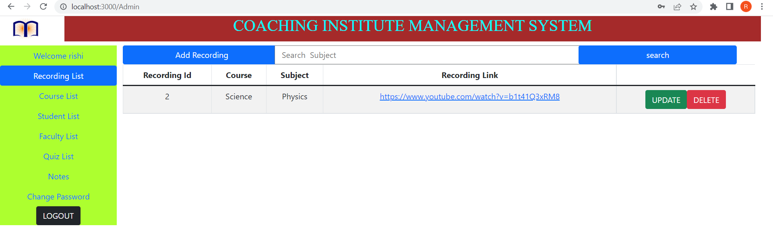
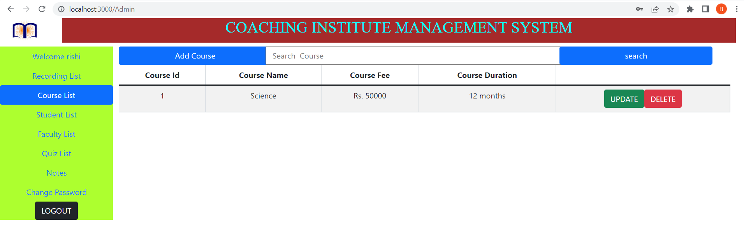
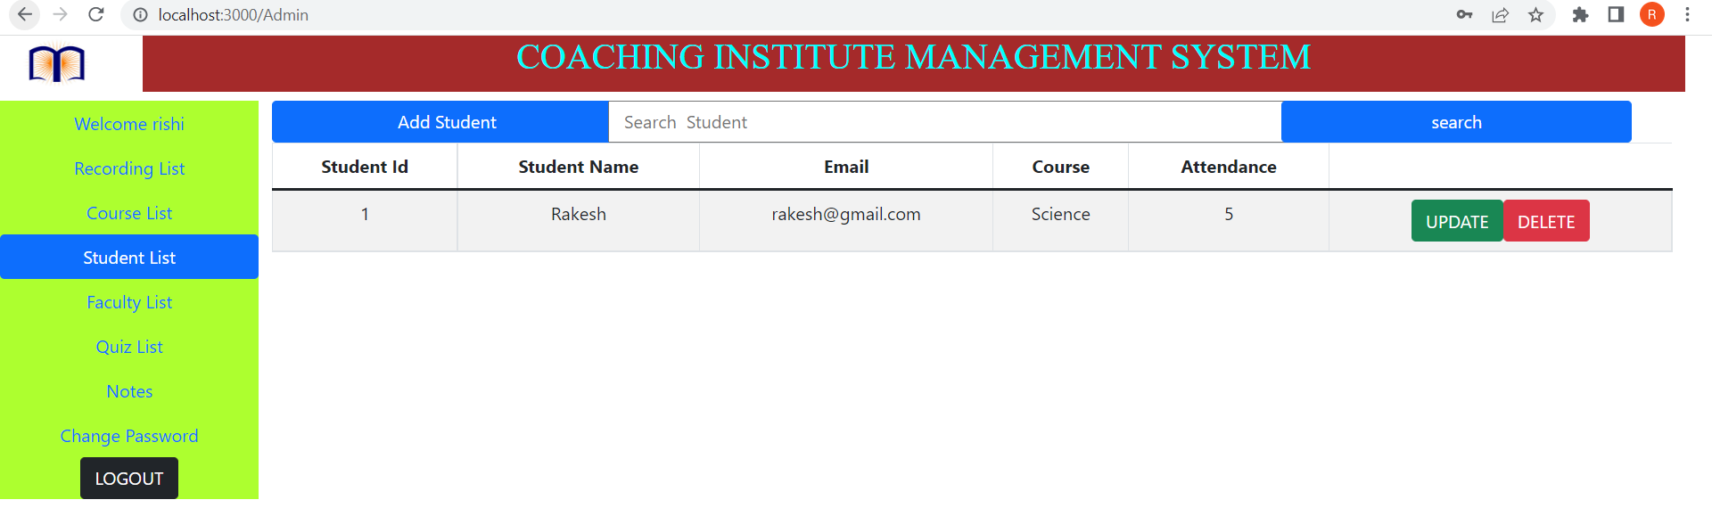

Slide 22
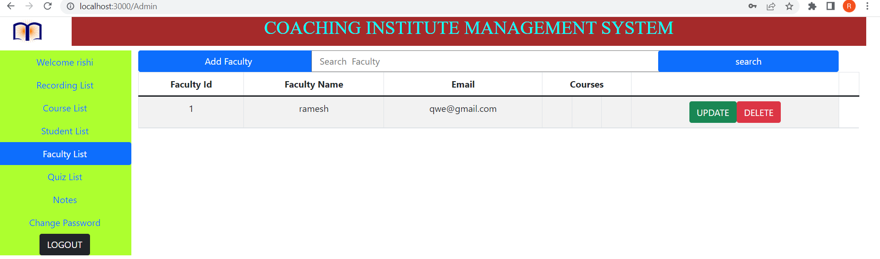
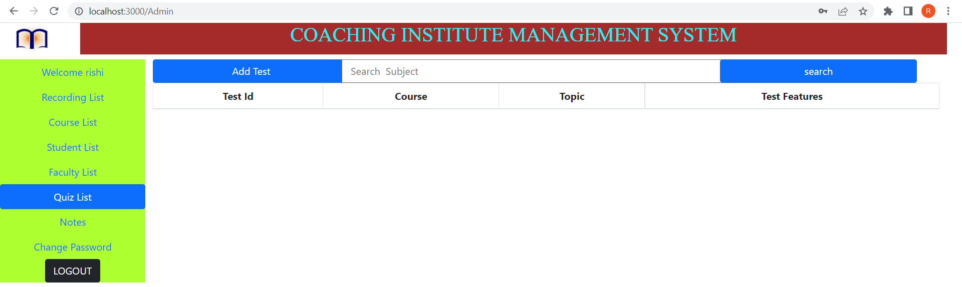
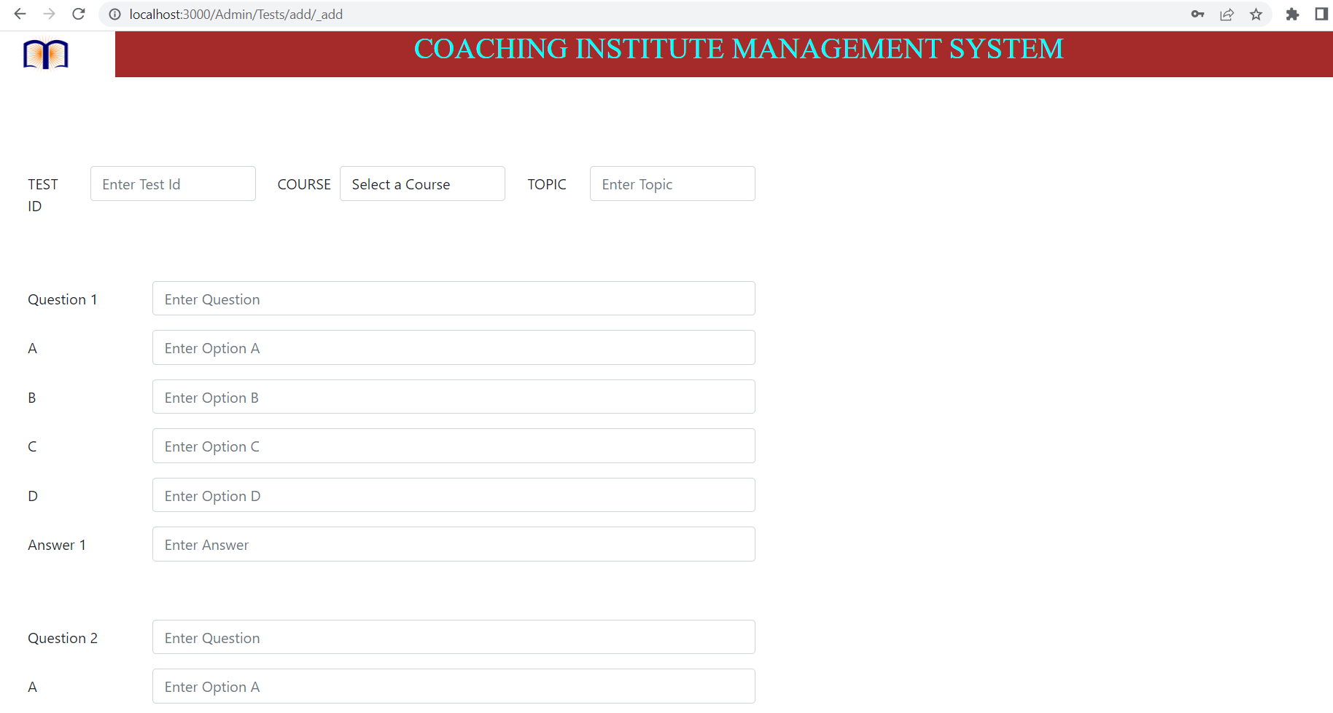
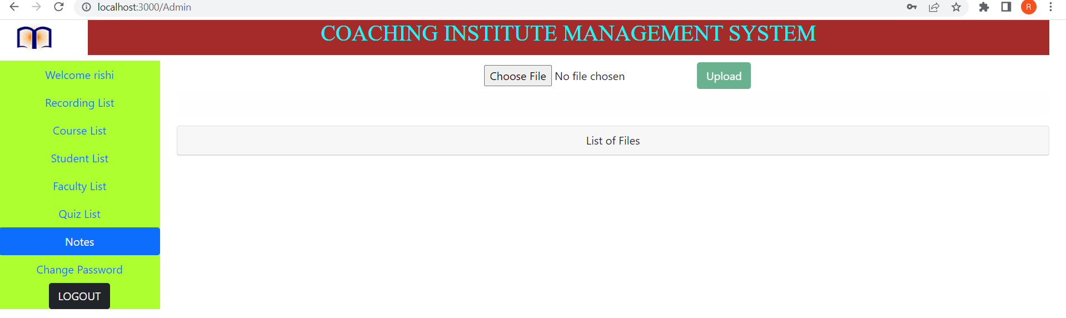

Slide 23
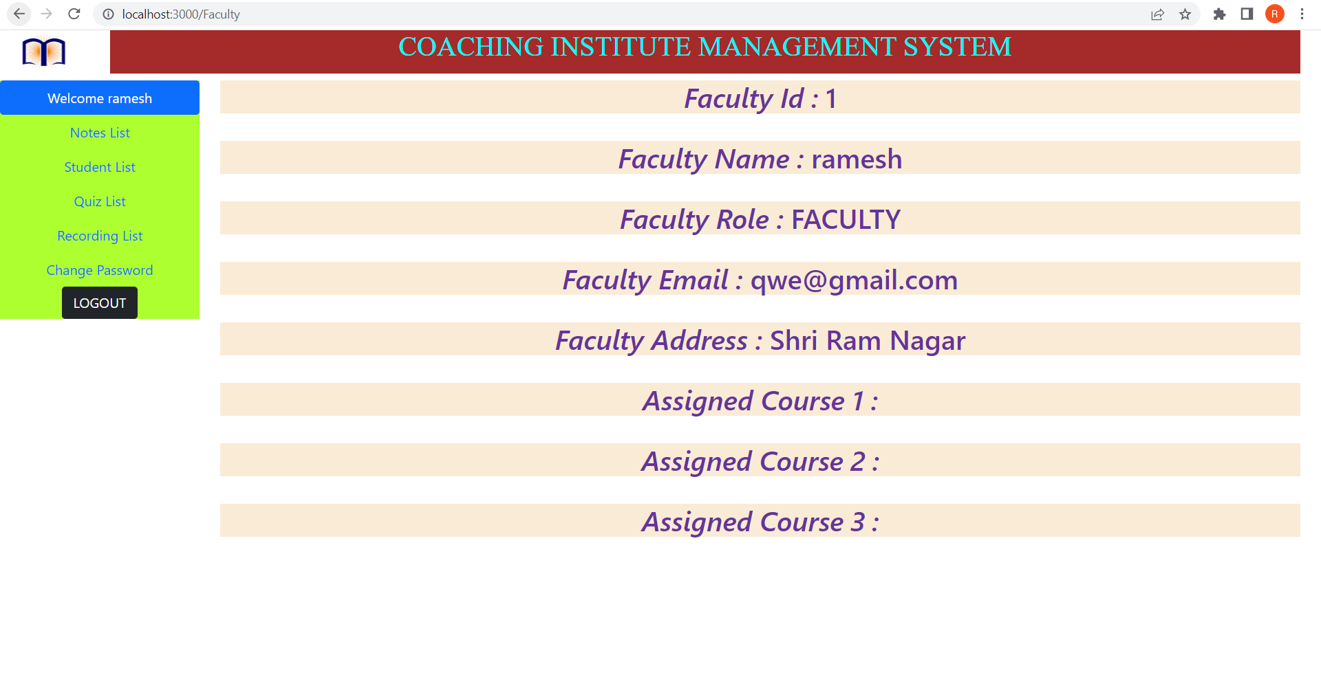

Slide 25
Specification
The application will use Spring boot, React JS as main web technologies.
My SQL is used as database technology.
Since Coaching Institute Management System(CIMS)is a web-based application, internet connection must be established.
The CIMS will be used on PCs and will function via internet or intranet in any web browser.

Slide 26
References
https://www.geeksforgeeks.org/
https://getbootstrap.com/
https://www.w3schools.com/

Slide 27
S/W and H/W Requirements
Server Side:
Processor: Intel® Xeon® processor 3500 series
HDD: Minimum 500GB Disk Space
RAM: Minimum 4GB
OS: Windows 10
Database: MySQL
Client Side (minimum requirement):
Processor: Intel Dual Core
HDD: Minimum 80GB Disk Space
RAM: Minimum 2GB
OS: Windows 7

Slide 28
Advantages
Managing student information.
Effortless Communication.
Lesser time requirement to maintain and manage records of student and faculty.
Paper work is reduced due to record stored into database.
All requirements at one platform.

Slide 29
Disadvantages
Manual admission or document submission is required for registering to system.

Slide 30
Conclusion
This project aid in automating the existing manual system. This is a paperless work. It can be monitored and guarded remotely. It cut down the man power required and provides accurate information. All years together huddled information can be saved and can be accessed at any time. For this reason, the data stored in the repository helps in taking decision by management. So, it is improved to have a Web Based system. All the stakeholders, faculty and authority can get the required information without delay. This system is crucial in the colleges and universities.

